Slide 1
Change Assignment 1 ,Question 2 into
Assignment 1
2. Explain the Speedup in case of the following instruction level pipeline architectures: linear pipeline ,superscalar pipeline and superpipeline architectures?
The following slides explain concepts of CPI and throughput of superscalar pipeline, superpipeline and VLIW processor architectures .

Slide 2
CPI-Superscalar
https://en.wikipedia.org/wiki/Cycles_per_instruction
classic RISC pipeline, with the following 5 stages:
Instruction fetch cycle (IF).
Instruction decode/Register fetch cycle (ID).
Execution/Effective address cycle (EX).
Memory access (MEM).
Write-back cycle (WB).
Each stage requires one clock cycle and an instruction passes through the stages sequentially. Without pipelining, a new instruction is fetched in stage 1 only after the previous instruction finishes at stage 5, therefore the number of clock cycles it takes to execute an instruction is 5 (CPI = 5 > 1). In this case, the processor is said to be subscalar. With pipelining, a new instruction is fetched every clock cycle by exploiting instruction-level parallelism, therefore, since one could theoretically have 5 instructions in the 5 pipeline stages at once (one instruction per stage), a different instruction would complete stage 5 in every clock cycle and on average the number of clock cycles it takes to execute an instruction is 1 (CPI = 1). In this case, the processor is said to be scalar.

Slide 3
CPI Superscalar contd..
With a single-execution-unit processor, the best CPI attainable is 1. However, with a multiple-execution-unit processor, one may achieve even better CPI values (CPI < 1). In this case, the processor is said to be superscalar. To get better CPI values without pipelining, the number of execution units must be greater than the number of stages. For example, with 6 executions units, 6 new instructions are fetched in stage 1 only after the 6 previous instructions finish at stage 5, therefore on average the number of clock cycles it takes to execute an instruction is 5/6 (CPI = 5/6 < 1). To get better CPI values with pipelining, there must be at least 2 execution units. For example, with 2 executions units, 2 new instructions are fetched every clock cycle by exploiting instruction-level parallelism, therefore 2 different instructions would complete stage 5 in every clock cycle and on average the number of clock cycles it takes to execute an instruction is 1/2 (CPI = 1/2 < 1).
If CPI = ½ then Instructions/clock = 2. If the frequency of the clock is known ie f clocks/sec
then
  Instructions /sec= Instructions/clock * f clocks/sec= 2 * f/sec = throughput

Slide 4
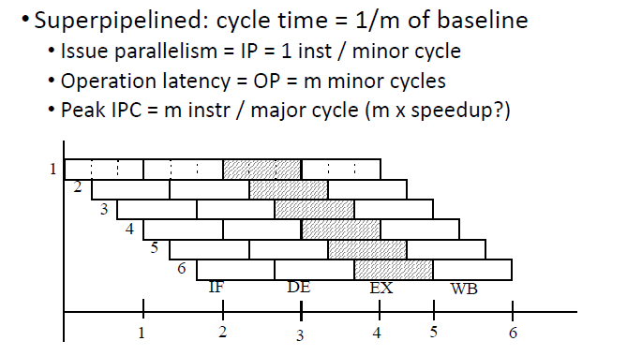
Instruction Level Parallelism Machine

Slide 5
CPI and Throughtput Superpipelined machines
Superpipelined machines can issue one instruction per minor cycle, minor cycle time is shorter than the time required for any operation(stage)-major cycle..
Cycle time shorter means frequency (f) higher of minor cycle.
Throughput = function(f) (See previous slide 3)
In previous slide
1 major cycle = 3 minor cycles
i.e 3 instuctions / 1 major cycle
3 * f(frequency of major clock cycle) = throughput
Therefore
CPI =1/3 major Clock cycle /Instruction

Slide 6
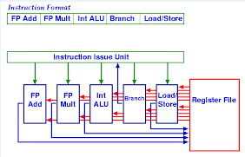
VLIW
• have much lower CPI.
• can issue 2 integer, 2 FP, 1 mem reference, and 1 branch instruction per cycle.
•can issues as many as 6 instructions at a time

